Slide 1


HOTEL RESERVATION ANALYSIS USING SQL.
USING SQL TO UNCOVER INSIGHTS FROM HOTEL RESERVATION DATA
BY HAVILAH ADEOYE

Slide 2
Overview of dataset-
In this project, we aim to leverage SQL to analyze a comprehensive hotel reservation dataset. The hotel industry thrives on data-driven decision-making, and by analyzing this dataset, we can uncover valuable insights into guest preferences, booking trends, and other critical factors influencing hotel operations. The dataset includes various attributes such as booking details, guest demographics, stay durations, and pricing information.

Slide 3
Dataset details
The dataset comprises the following columns:
Booking_ID: A unique identifier for each hotel reservation.
no_of_adults: The number of adults in the reservation.
no_of_children: The number of children in the reservation.
no_of_weekend_nights: The number of weekend nights in the reservation.
no_of_week_nights: The number of weeknights in the reservation.
type_of_meal_plan: The meal plan chosen by the guests.
room_type_reserved: The type of room reserved by the guests.
lead_time: The number of days between booking and arrival.
arrival_date: The date of arrival.
market_segment_type: The market segment to which the reservation belongs.
avg_price_per_room: The average price per room in the reservation.
booking_status: The status of the booking (e.g., confirmed, cancelled).

Slide 4
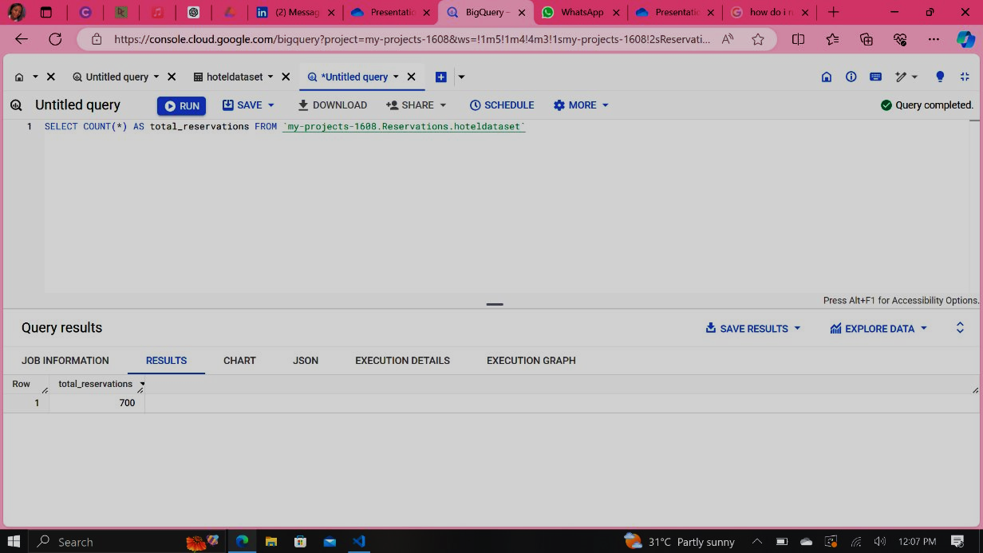
Analysis Tasks
1. Calculate the total number of reservations

Slide 5
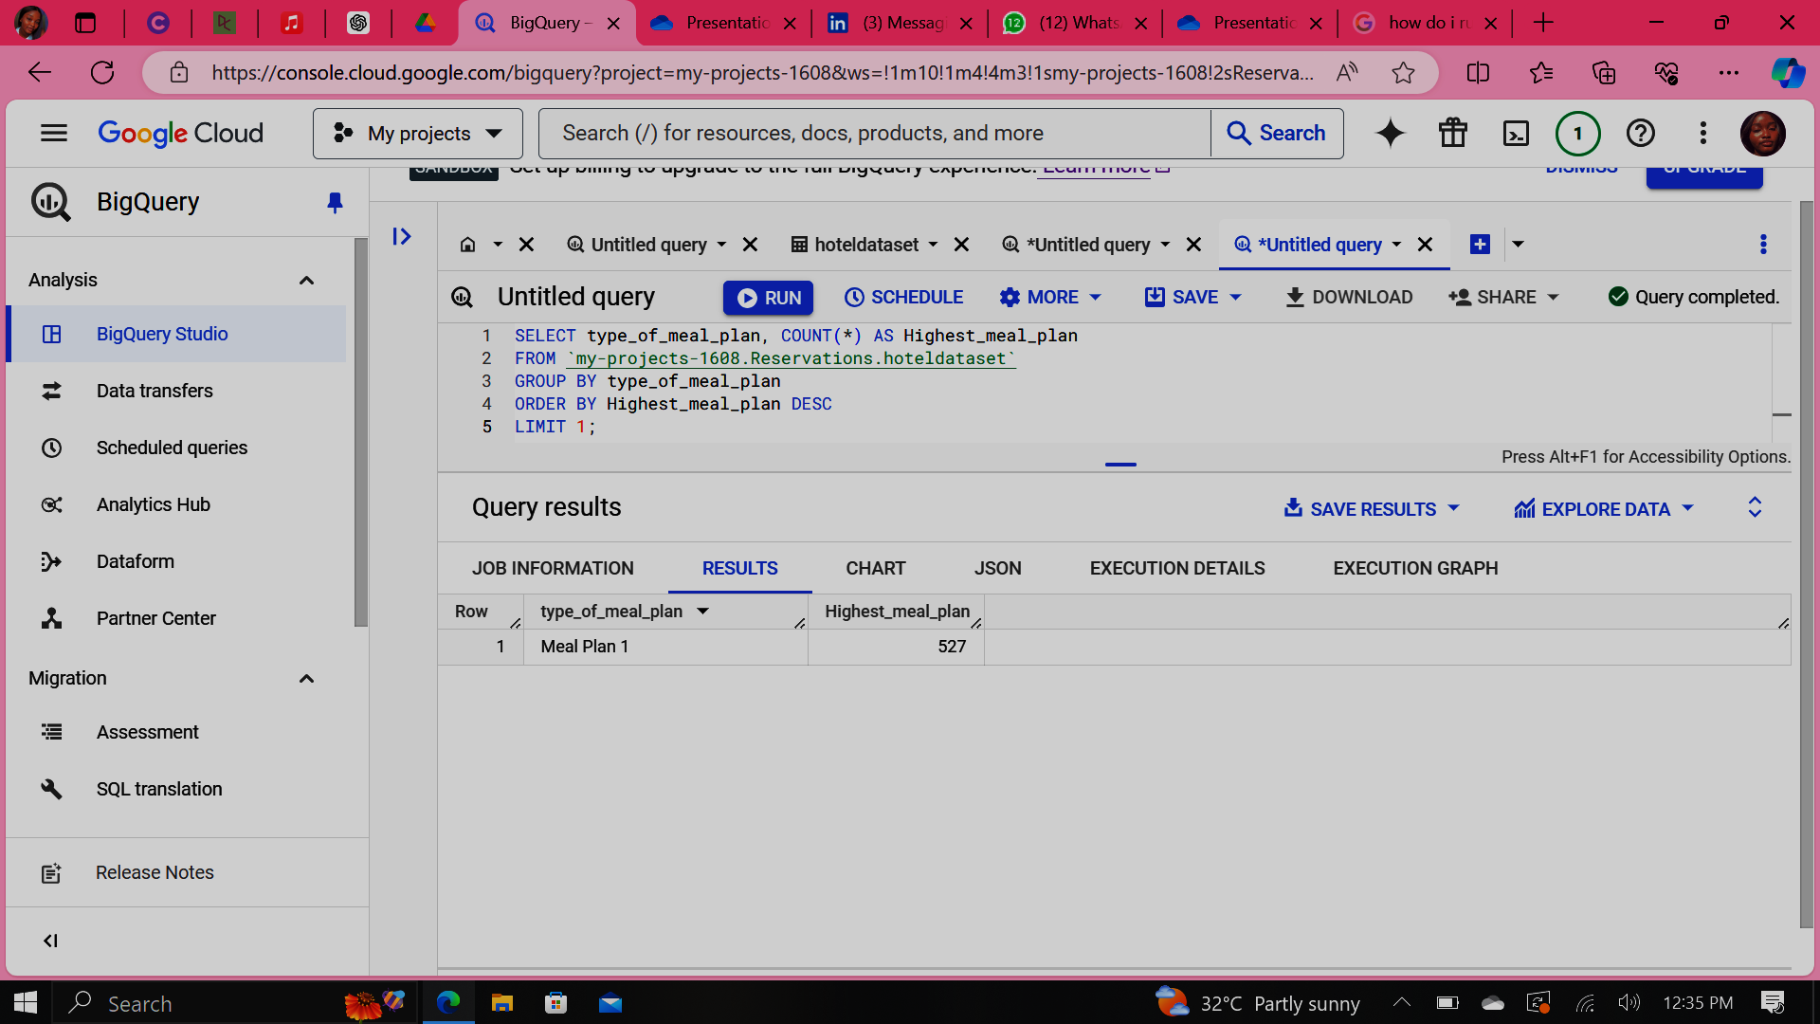
2. Which meal plan is the most popular among guests?

Slide 6
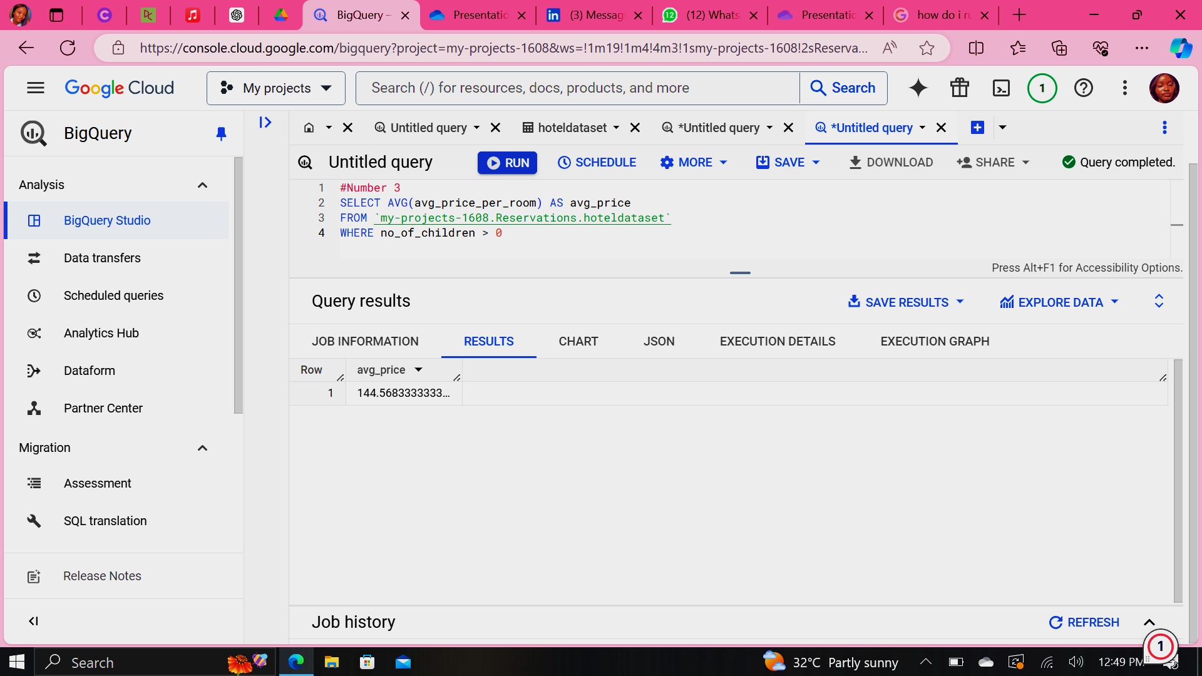
3.What is the average price per room for reservations involving children?

Slide 7
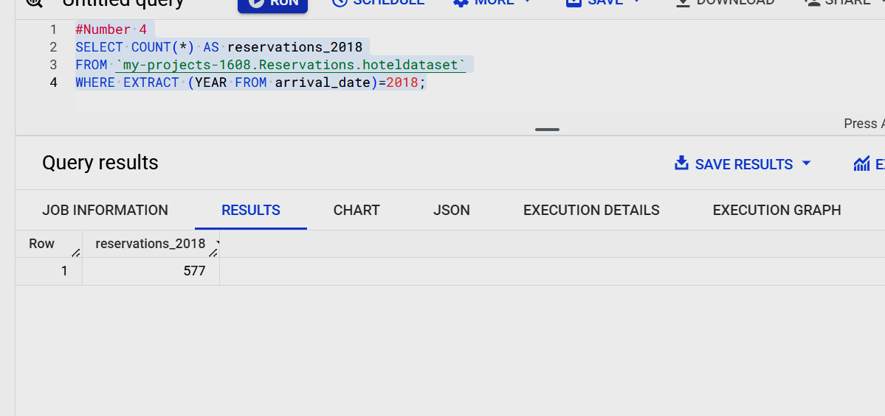
4.How many reservations were made for year 2018?

Slide 8
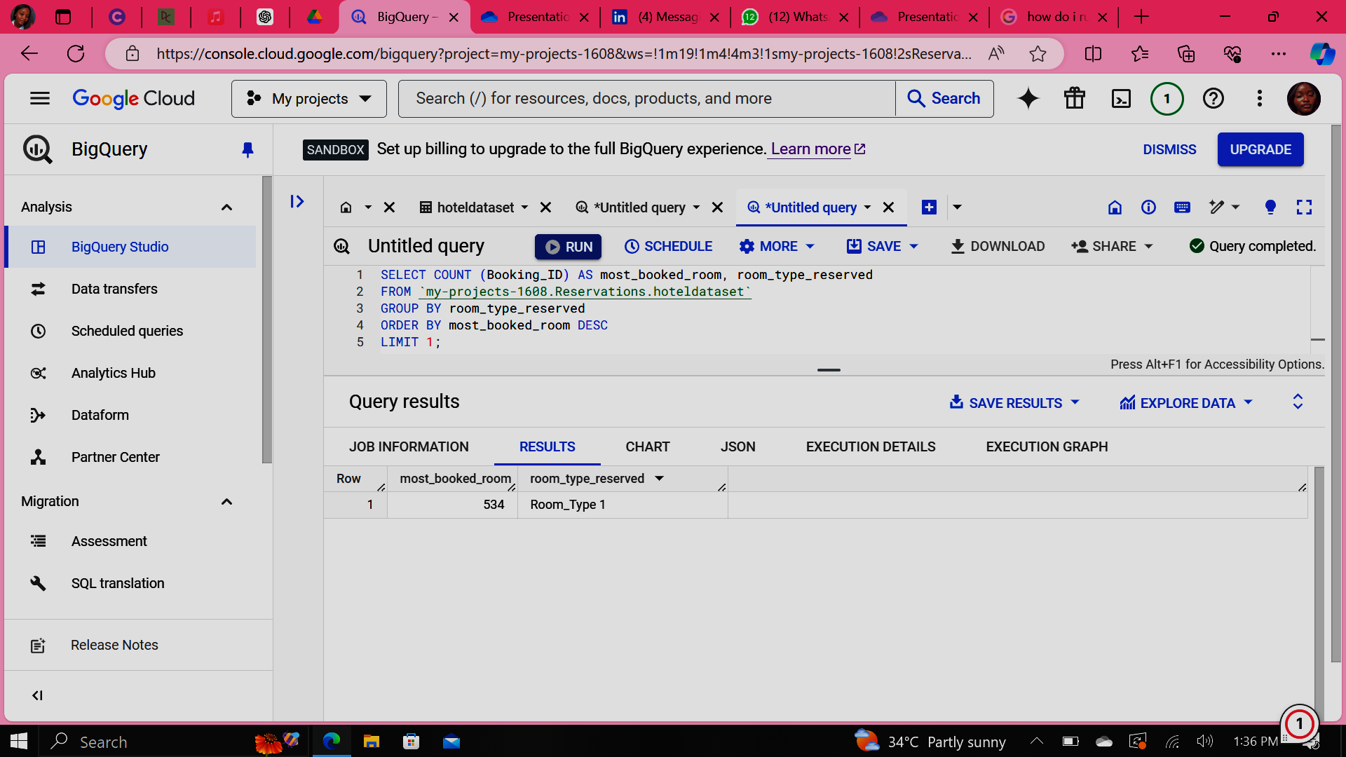
5.What is the most commonly booked room type?

Slide 9
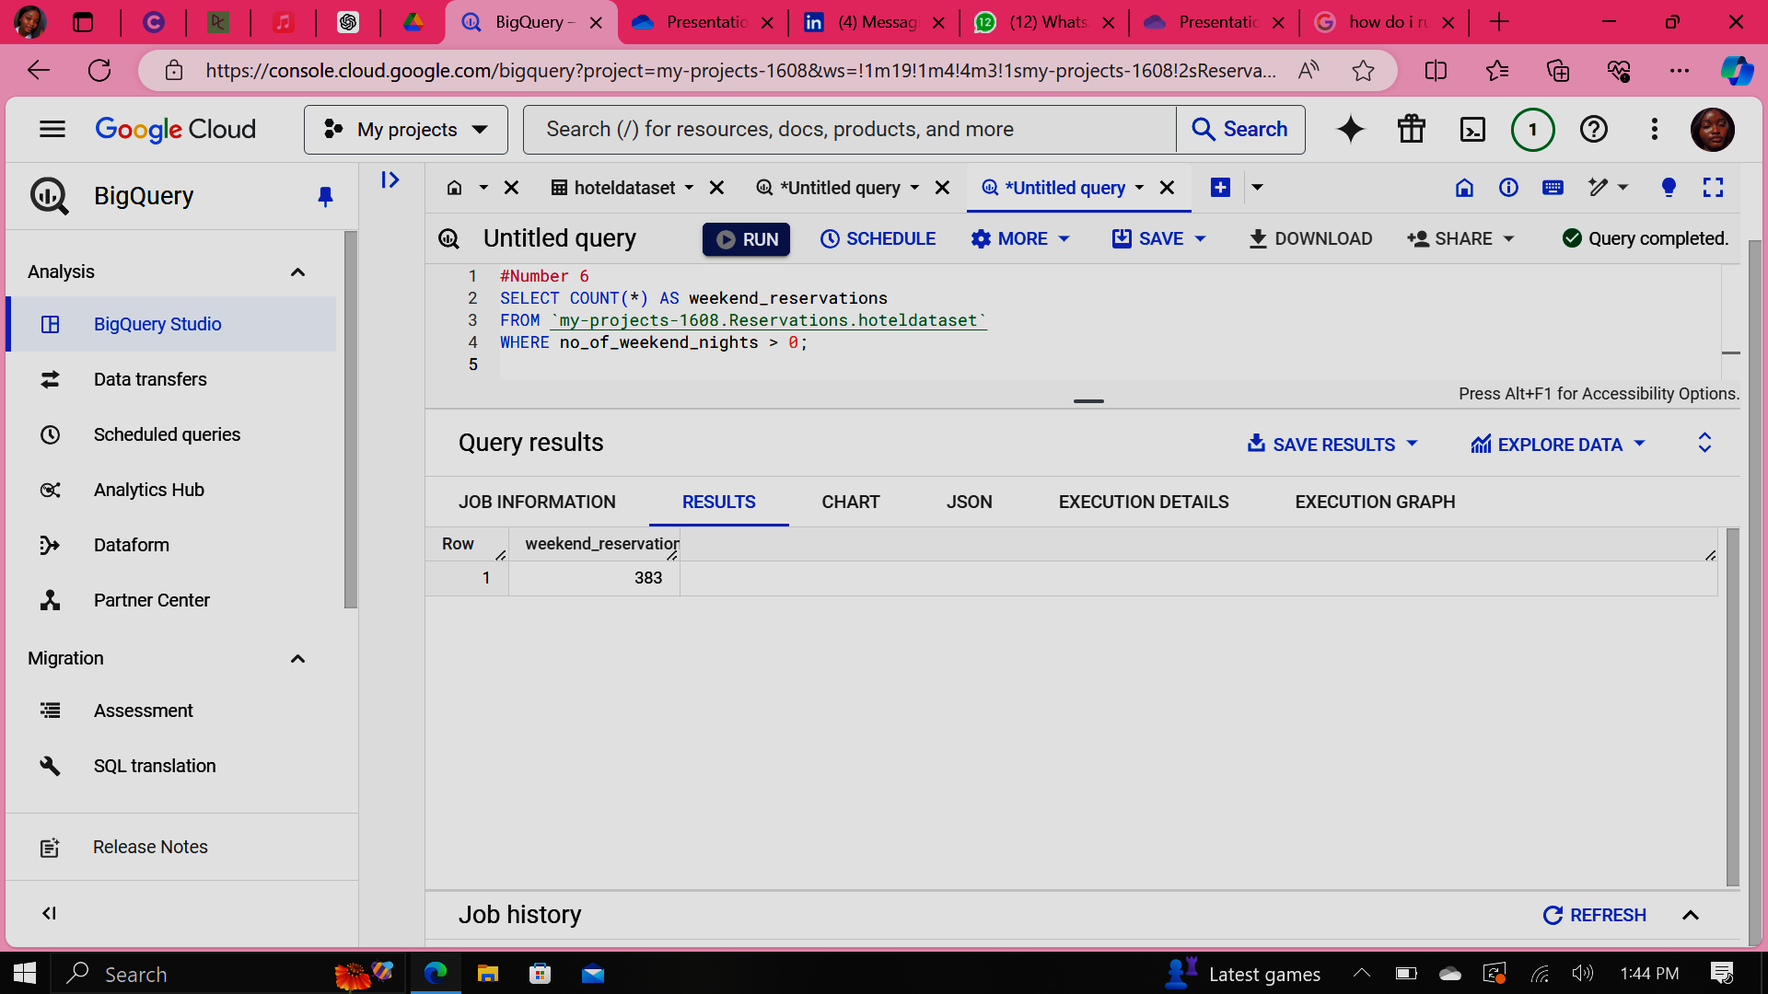
6. How many reservations fall on the weekend?

Slide 10
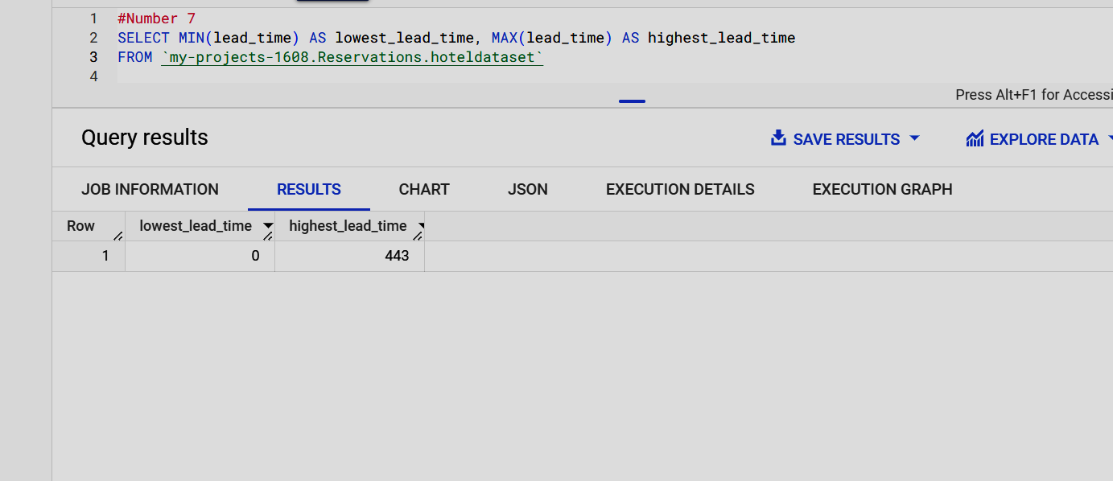
7.What is the highest and lowest time lead for reservations?

Slide 11
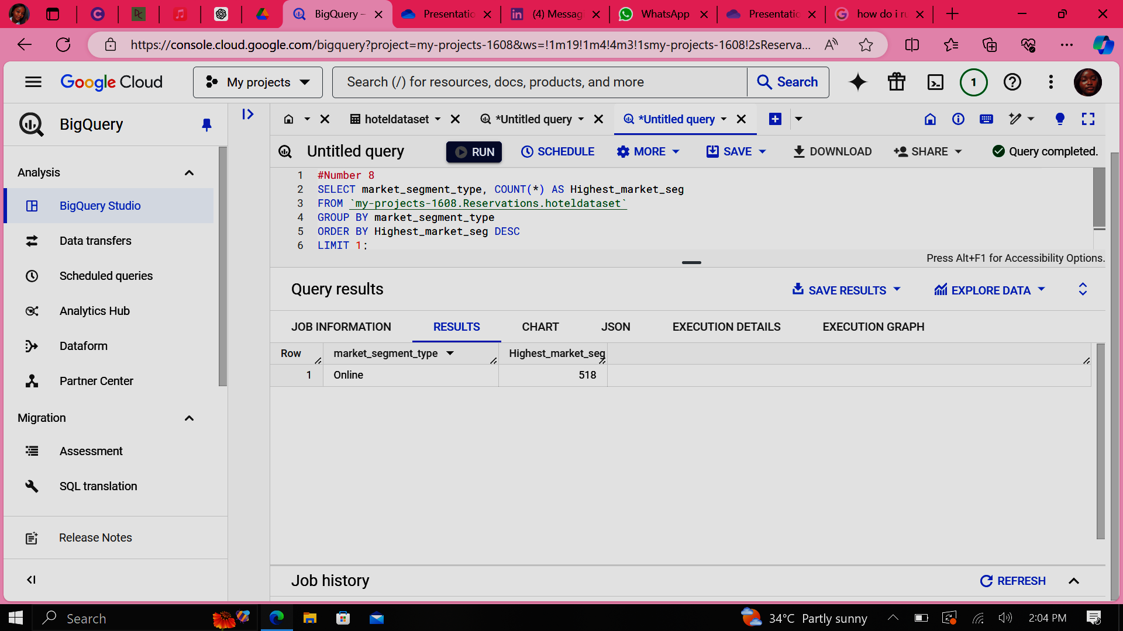
8.What is the most common market segment type for reservations?

Slide 12
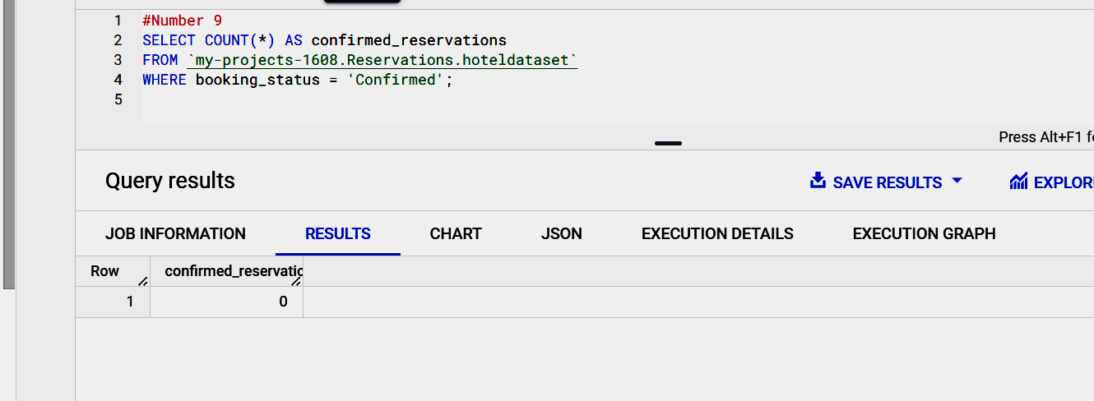
9.How many reservations have a booking status of "confirmed"?

Slide 13
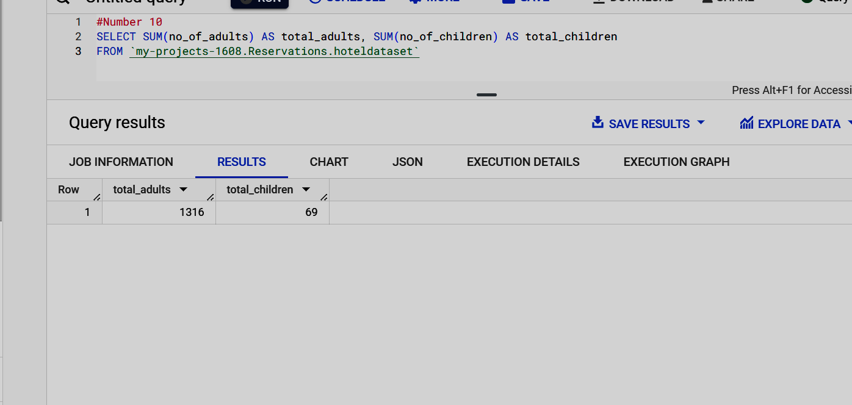
10. What is the total number of children and adults across all reservations?

Slide 14
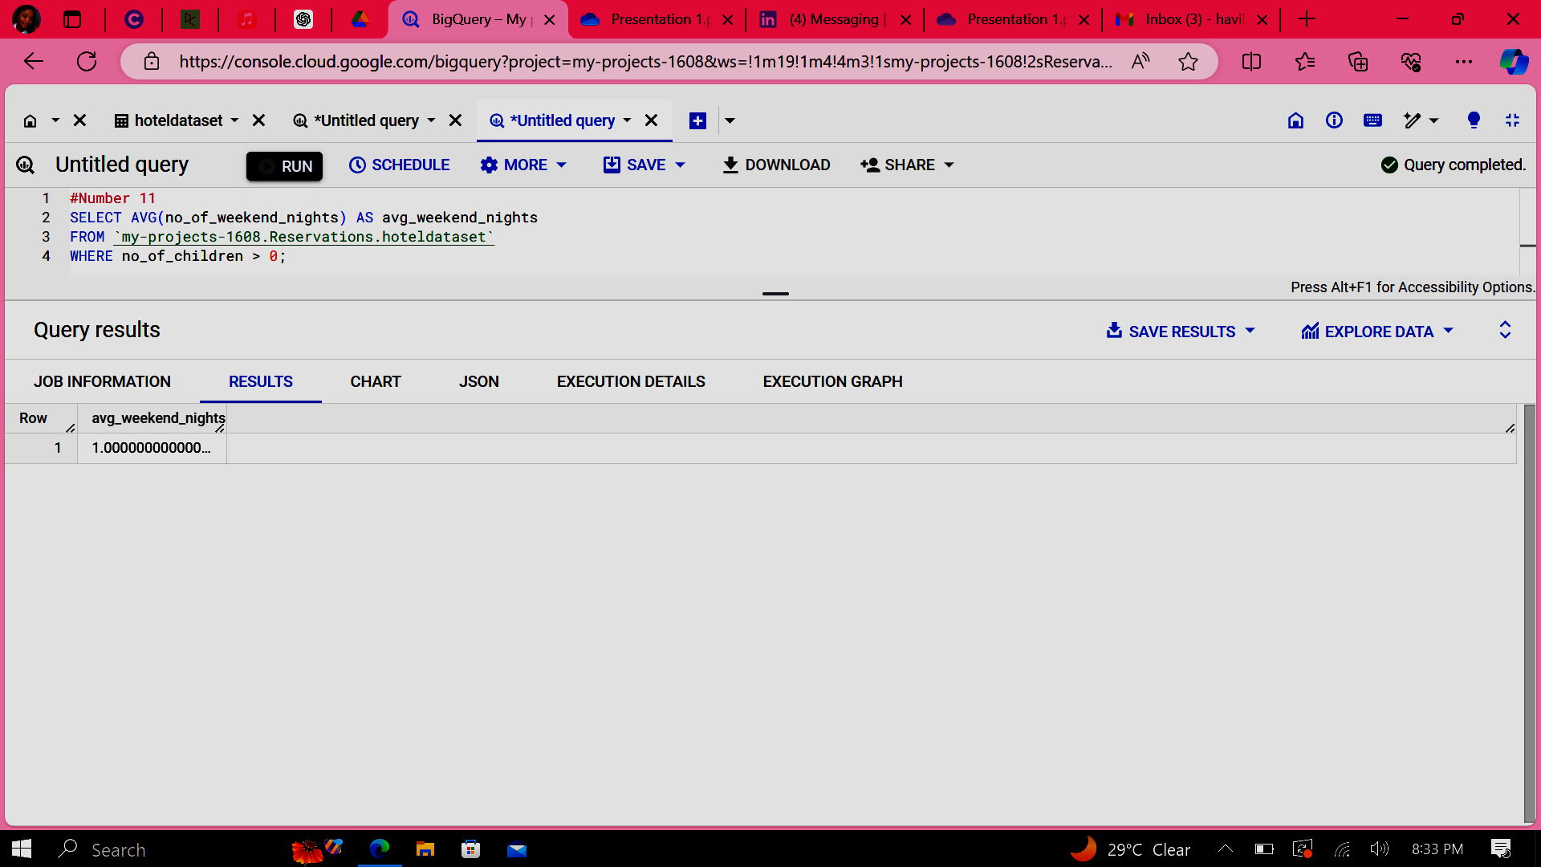
11. What is the average number of weekend nights for reservations involving children?

Slide 15
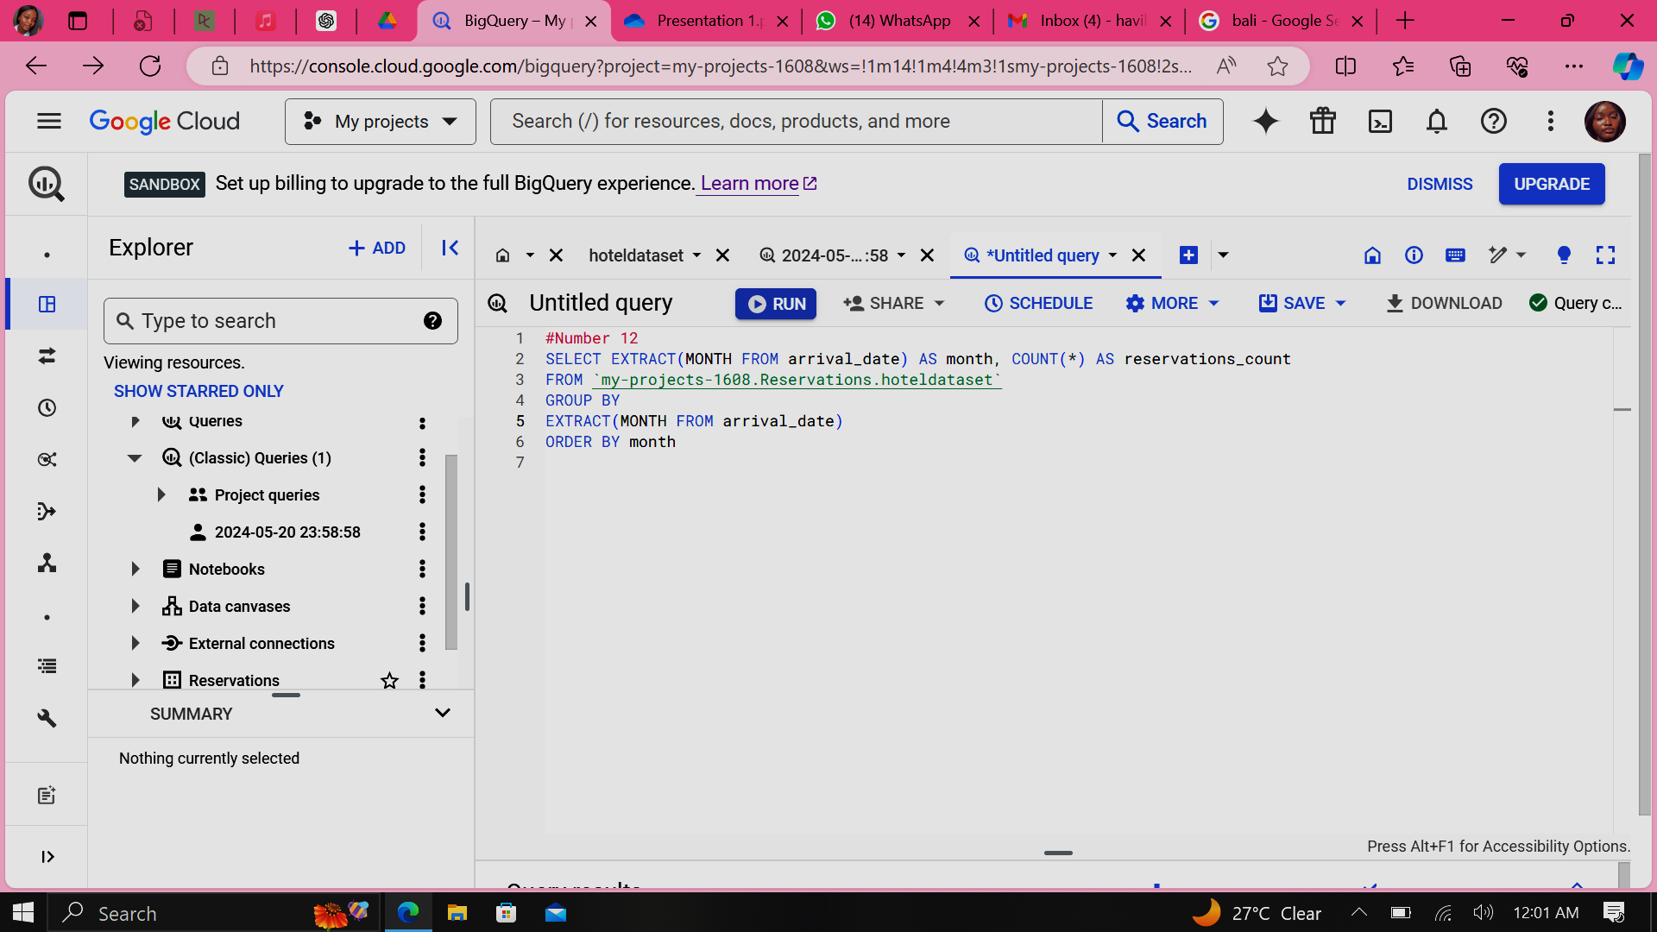
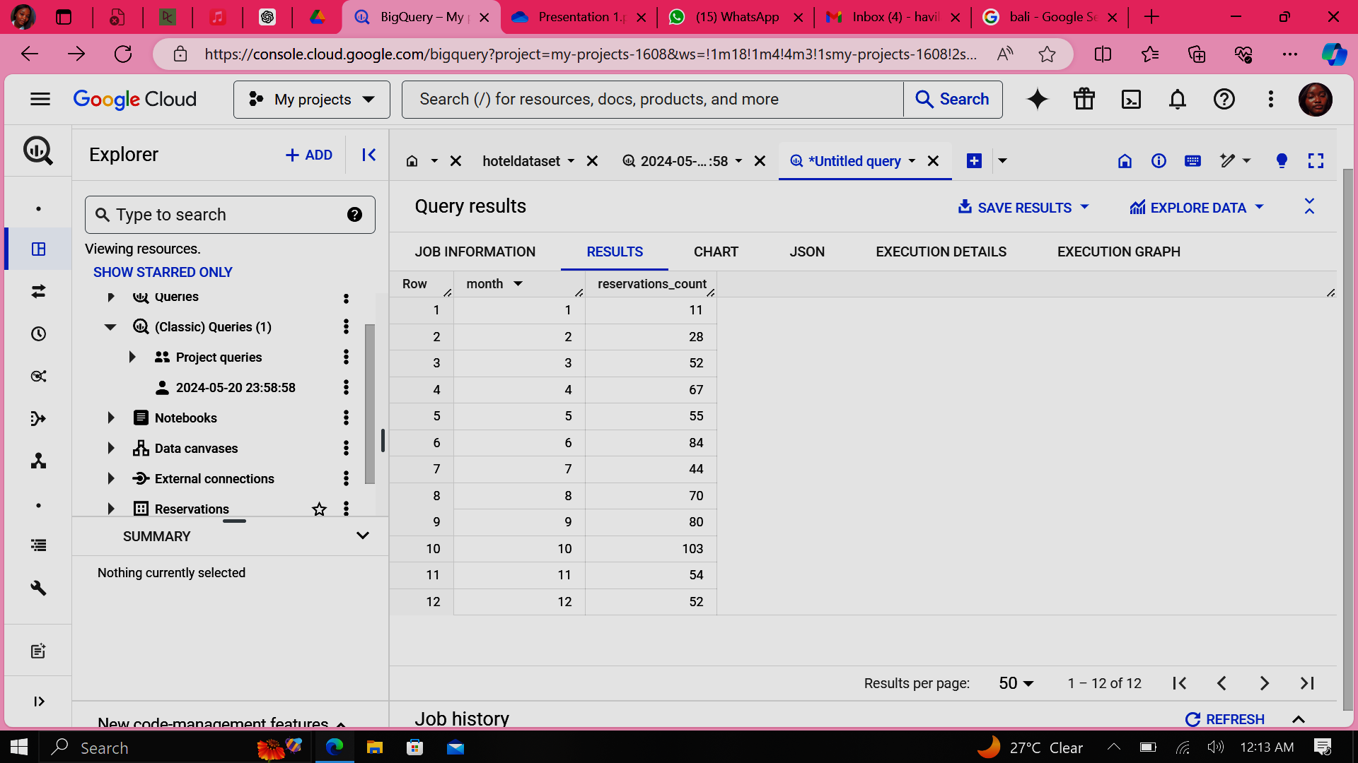
12. How many reservations were made in each month of the year?

Slide 16
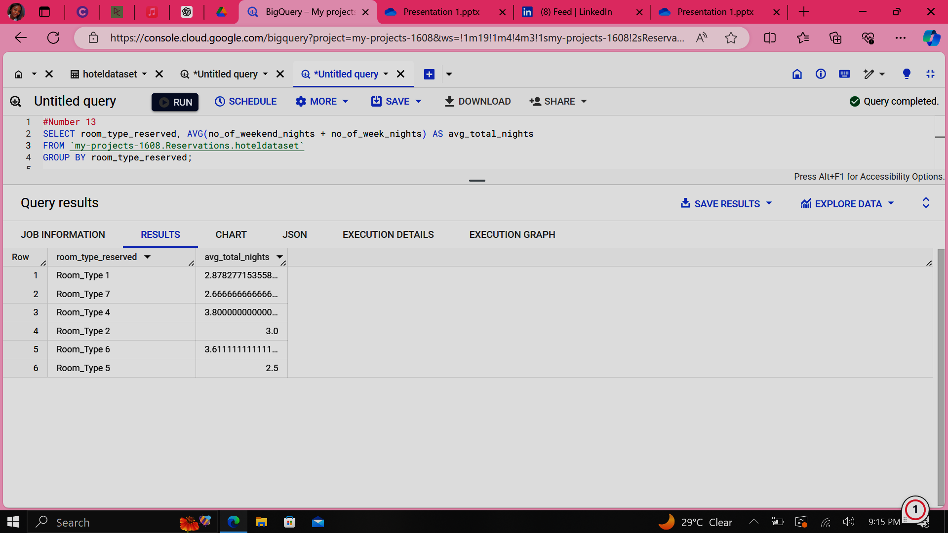
13. What is the average number of nights(both weekend and weekday) spent by guests for each room type?

Slide 17
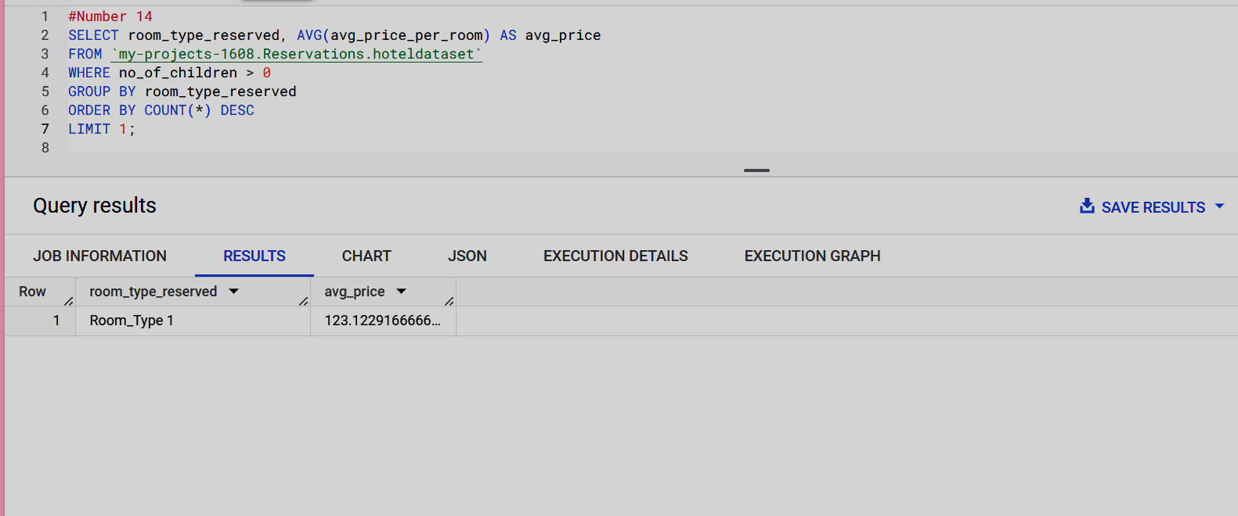
14. For reservations involving children, what is the most common room type, and what is the average price for that room type?

Slide 18
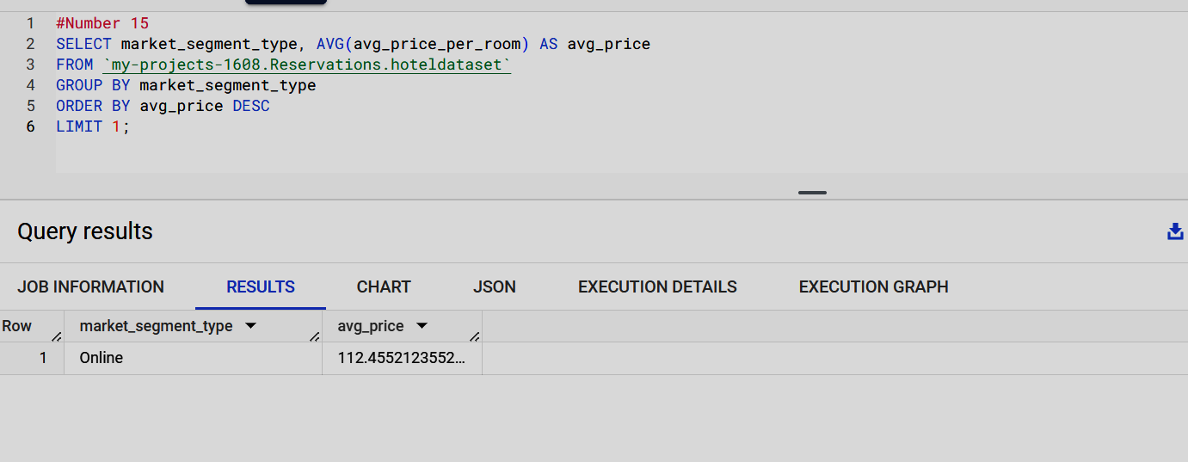
15. Find the market segment type that generates the highest average price per room?

Slide 19
Potential future analyses
For continued insights and improvement, consider the following future analyses:
Customer Satisfaction Analysis: Analyze guest reviews and feedback to gauge satisfaction and identify areas for improvement.
Revenue Management: Examine revenue patterns to optimize pricing strategies based on demand and market conditions.
Competitor Analysis: Compare the hotel's performance with competitors to identify competitive advantages and opportunities.
Seasonal Trends: Study seasonal booking trends in more detail to tailor marketing campaigns and promotions.
Loyalty Program Impact: Assess the effectiveness of loyalty programs on guest retention and repeat bookings.

